Slide 1
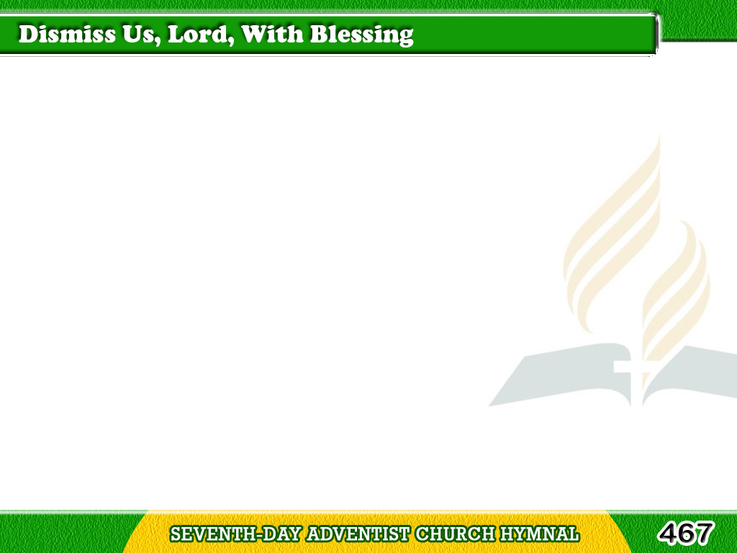
1/1
Dismiss us, Lord,
with blessing, we pray;
As from Thy worship
we go our ways;
Tagalog
Version

Slide 2
1/1
Guide in life’s conflicts,
all through the day;
Save in Thy kingdom,
Thine be the praise. Amen.
Tagalog
Version

